Slide 1
Jakarta, Indonesia
Unique admin level 1 names: ['Aceh' 'Bali' 'Bangka Belitung' 'Banten' 'Bengkulu' 'Gorontalo' 'Jakarta Raya' 'Jambi' 'Jawa Barat' 'Jawa Tengah' 'Jawa Timur' 'Kalimantan Barat' 'Kalimantan Selatan' 'Kalimantan Tengah' 'Kalimantan Timur' 'Kalimantan Utara' 'Kepulauan Riau' 'Lampung' 'Maluku' 'Maluku Utara' 'Nusa Tenggara Barat' 'Nusa Tenggara Timur' 'Papua' 'Papua Barat' 'Riau' 'Sulawesi Barat' 'Sulawesi Selatan' 'Sulawesi Tengah' 'Sulawesi Tenggara' 'Sulawesi Utara' 'Sumatera Barat' 'Sumatera Selatan' 'Sumatera Utara' 'Yogyakarta']
Unique admin level 2 names in ‘Jakarta Raya’: ['Jakarta Barat' 'Jakarta Pusat' 'Jakarta Selatan' 'Jakarta Timur' 'Jakarta Utara' 'Kepulauan Seribu*’]
Level 1 type: Provinces
Level 2 type: Kota (city)
* This Kota is excluded as it consists primarily of islands off the coast of Jakarta

Slide 2
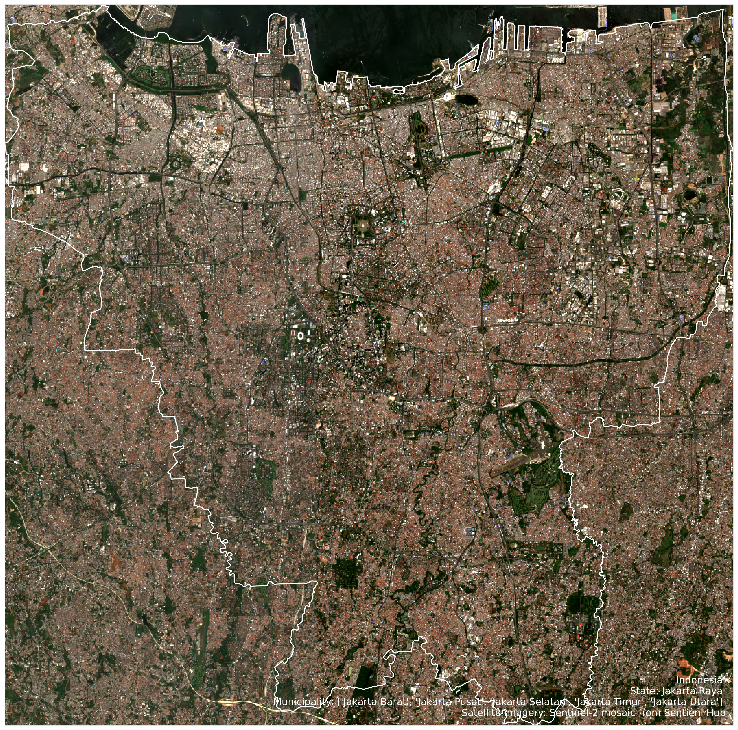
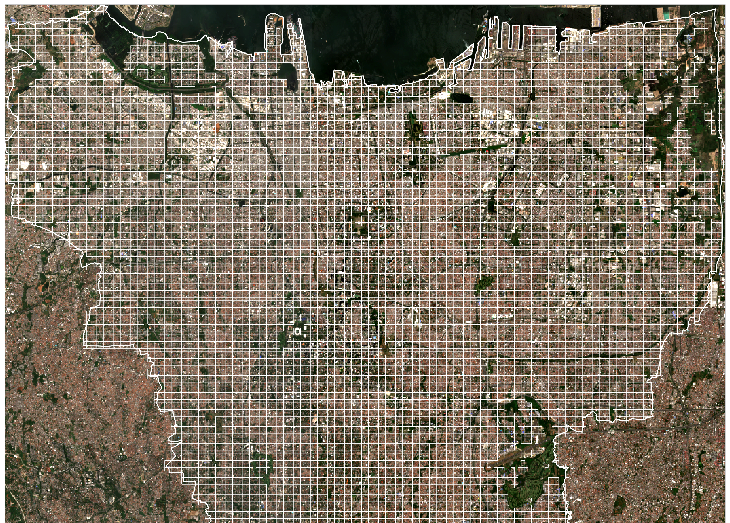


Slide 3
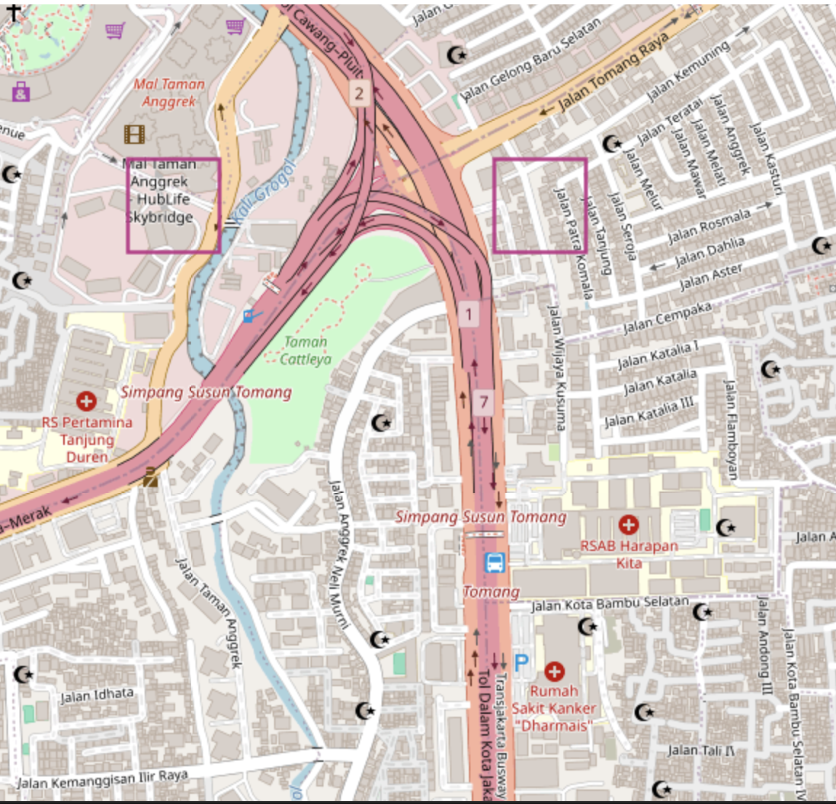
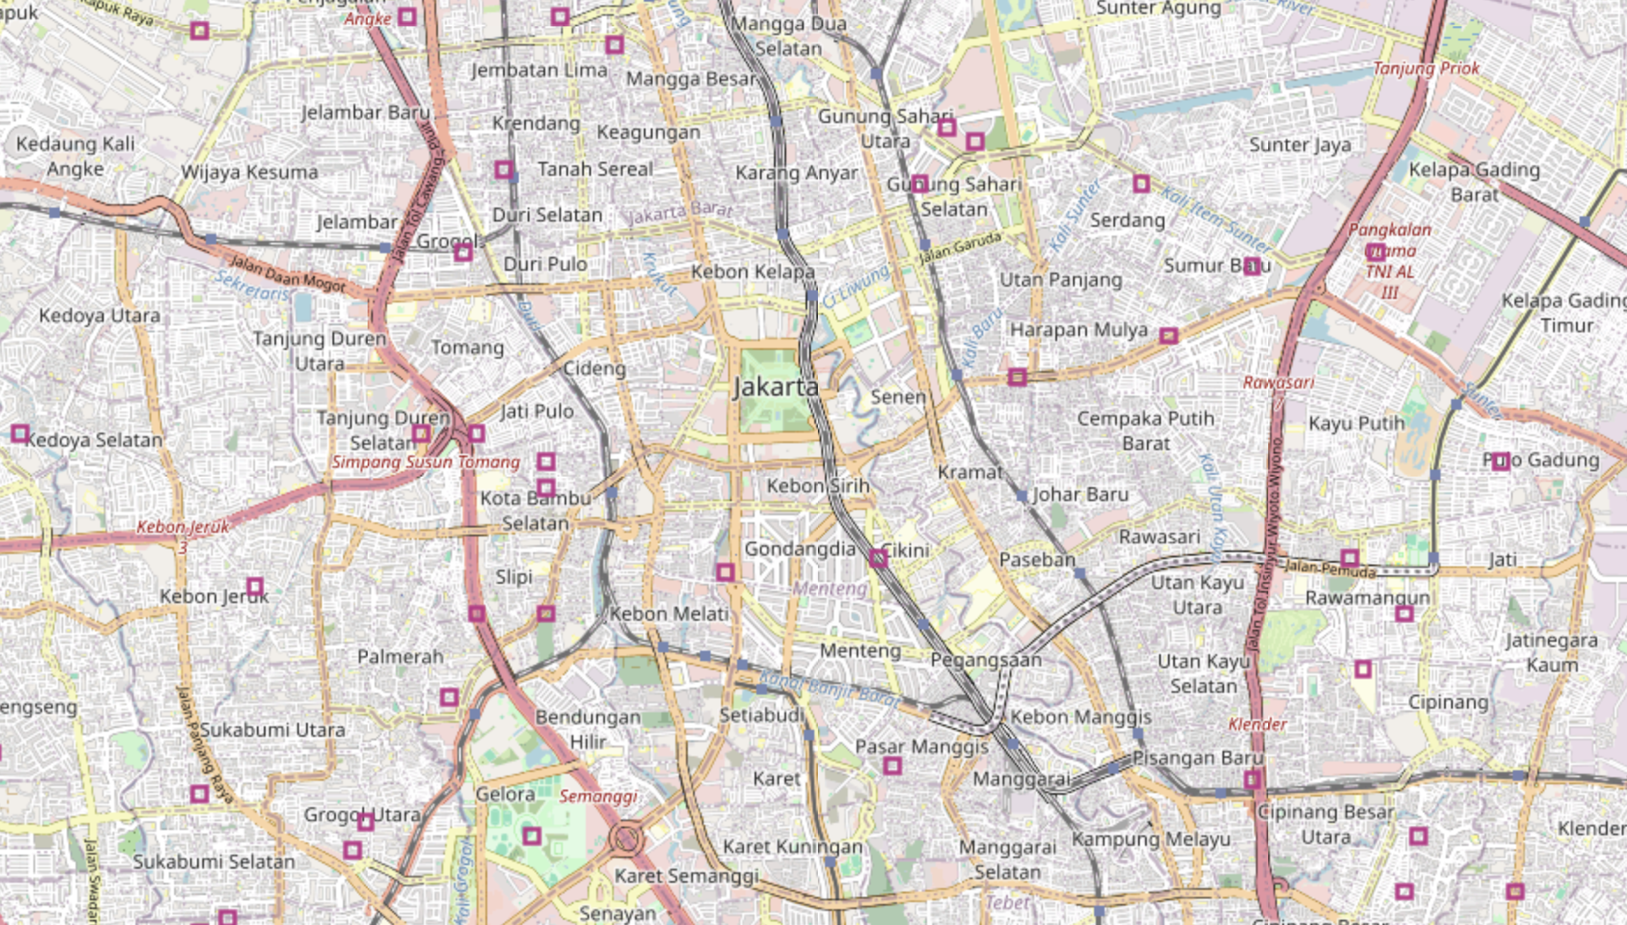

Slide 4
Sao Paulo, Brazil
Unique admin level 1 names: ['Acre' 'Alagoas' 'Amapá' 'Amazonas' 'Bahia' 'Ceará' 'Distrito Federal' 'Espírito Santo' 'Goiás' 'Maranhão' 'Mato Grosso' 'Mato Grosso do Sul' 'Minas Gerais' 'Pará' 'Paraíba' 'Paraná' 'Pernambuco' 'Piauí' 'Rio de Janeiro' 'Rio Grande do Norte' 'Rio Grande do Sul' 'Rondônia' 'Roraima' 'Santa Catarina' 'São Paulo' 'Sergipe' 'Tocantins’]
Unique admin level 2 names in São Paulo: [Too many to list]
Level 1 type: States
Level 2 type: Municipalities

Slide 5
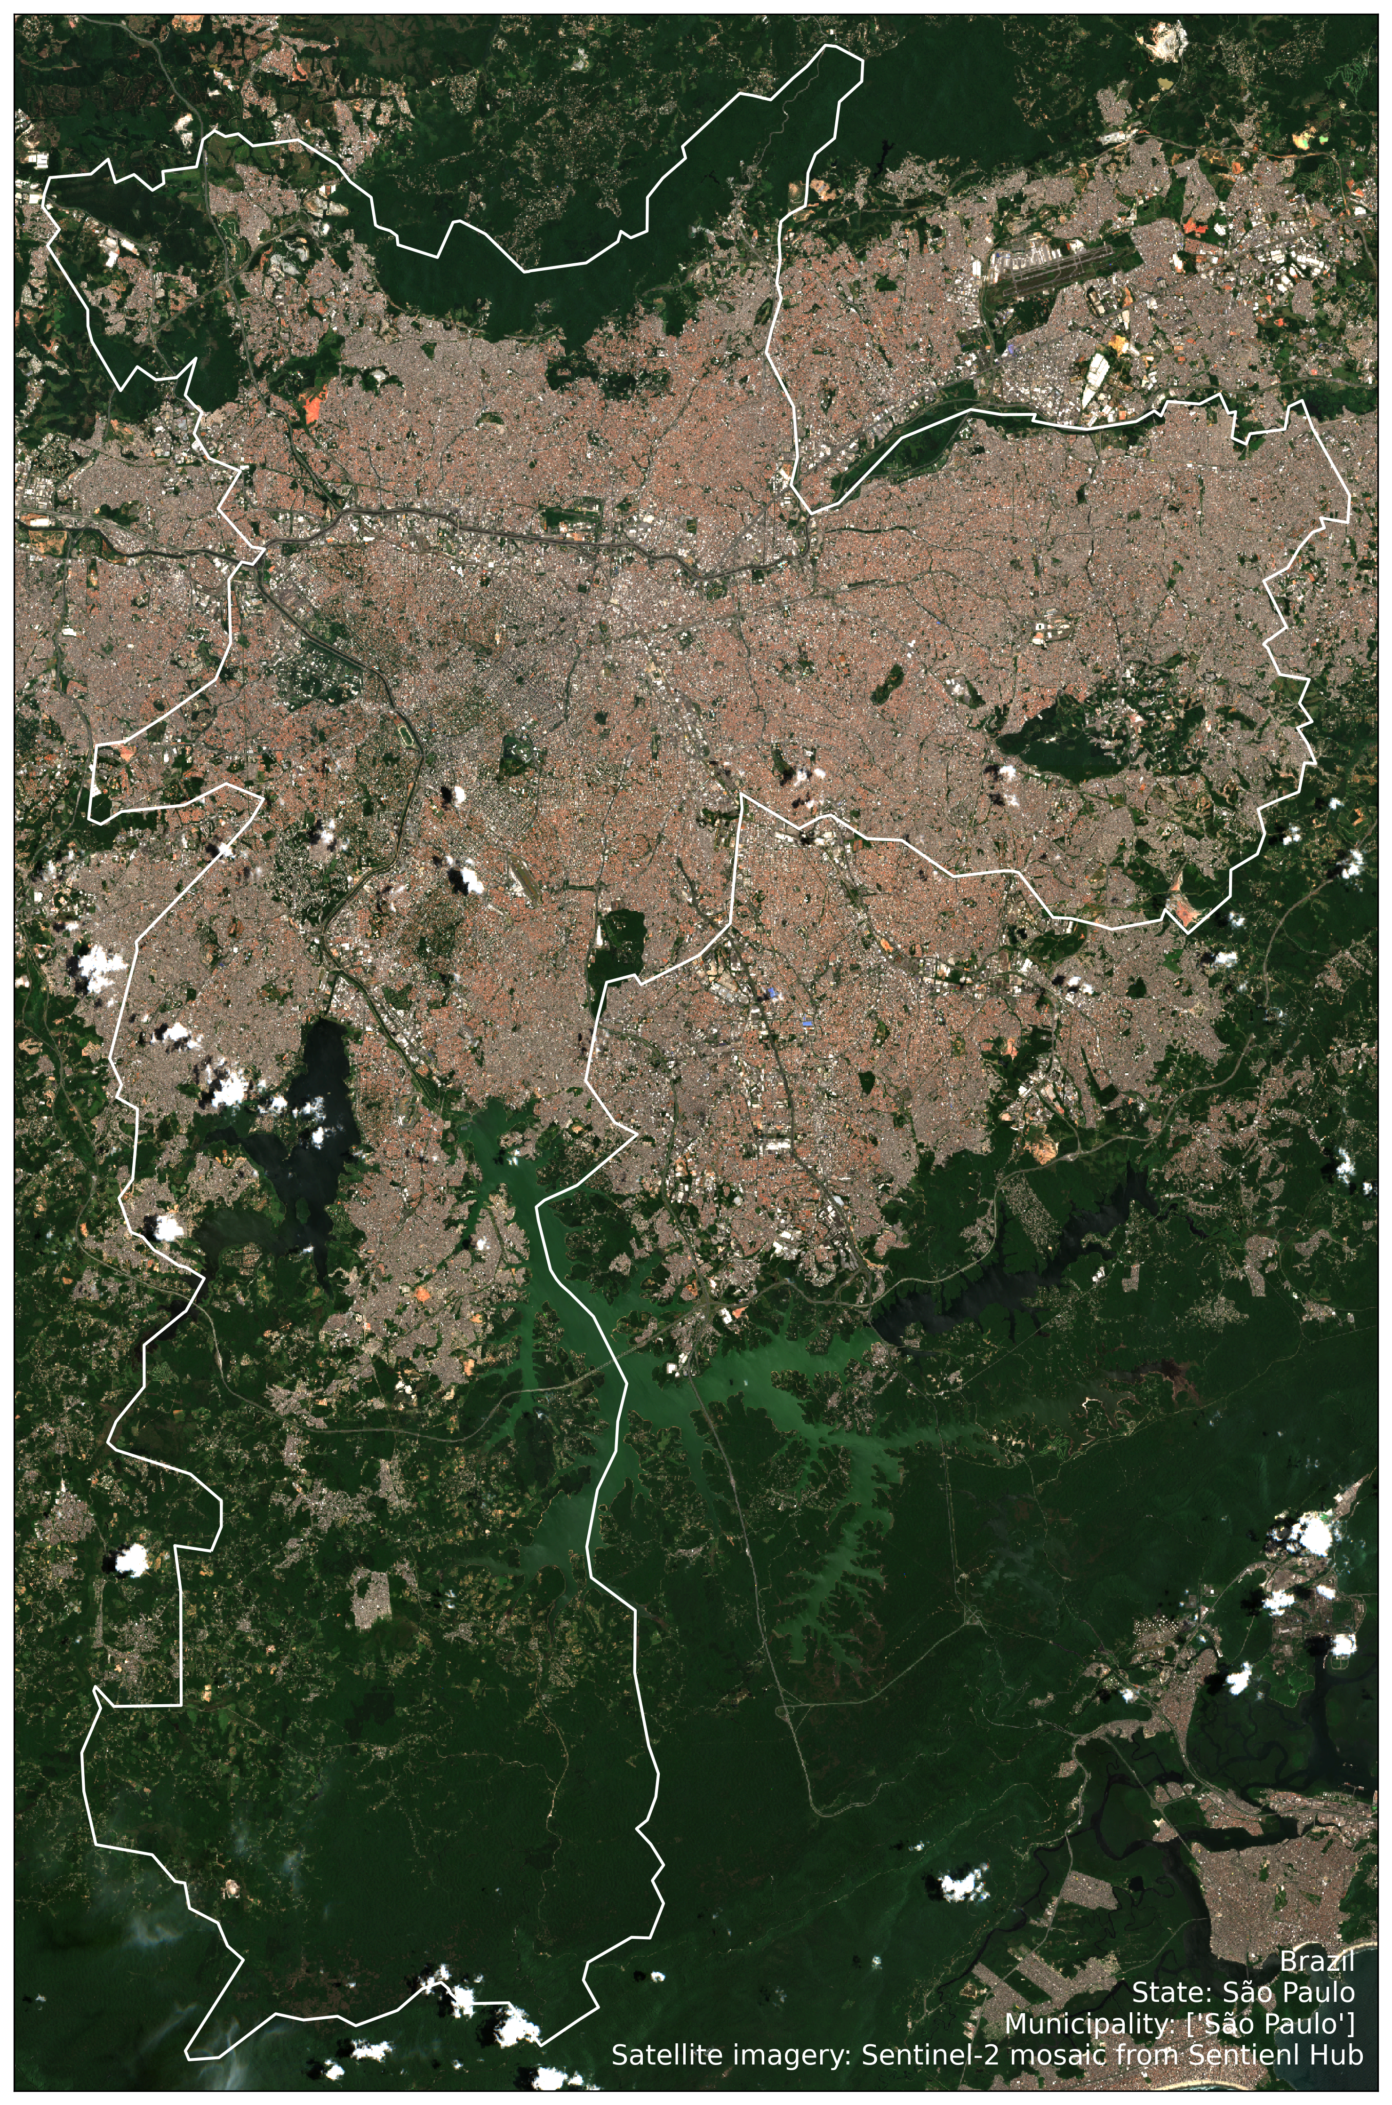
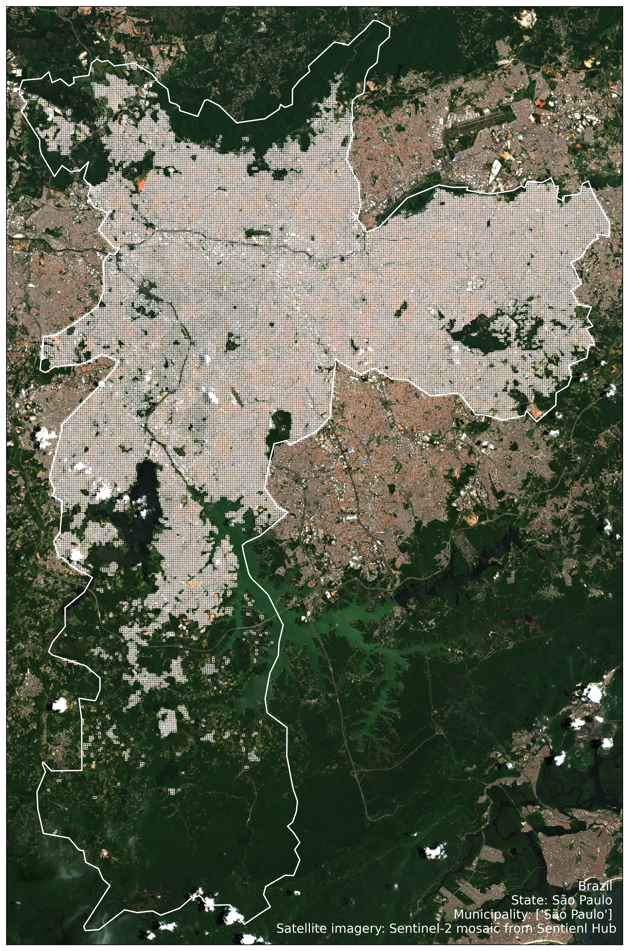


Slide 6
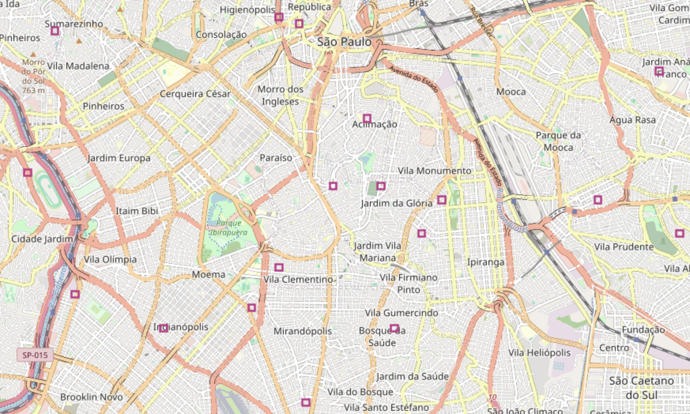
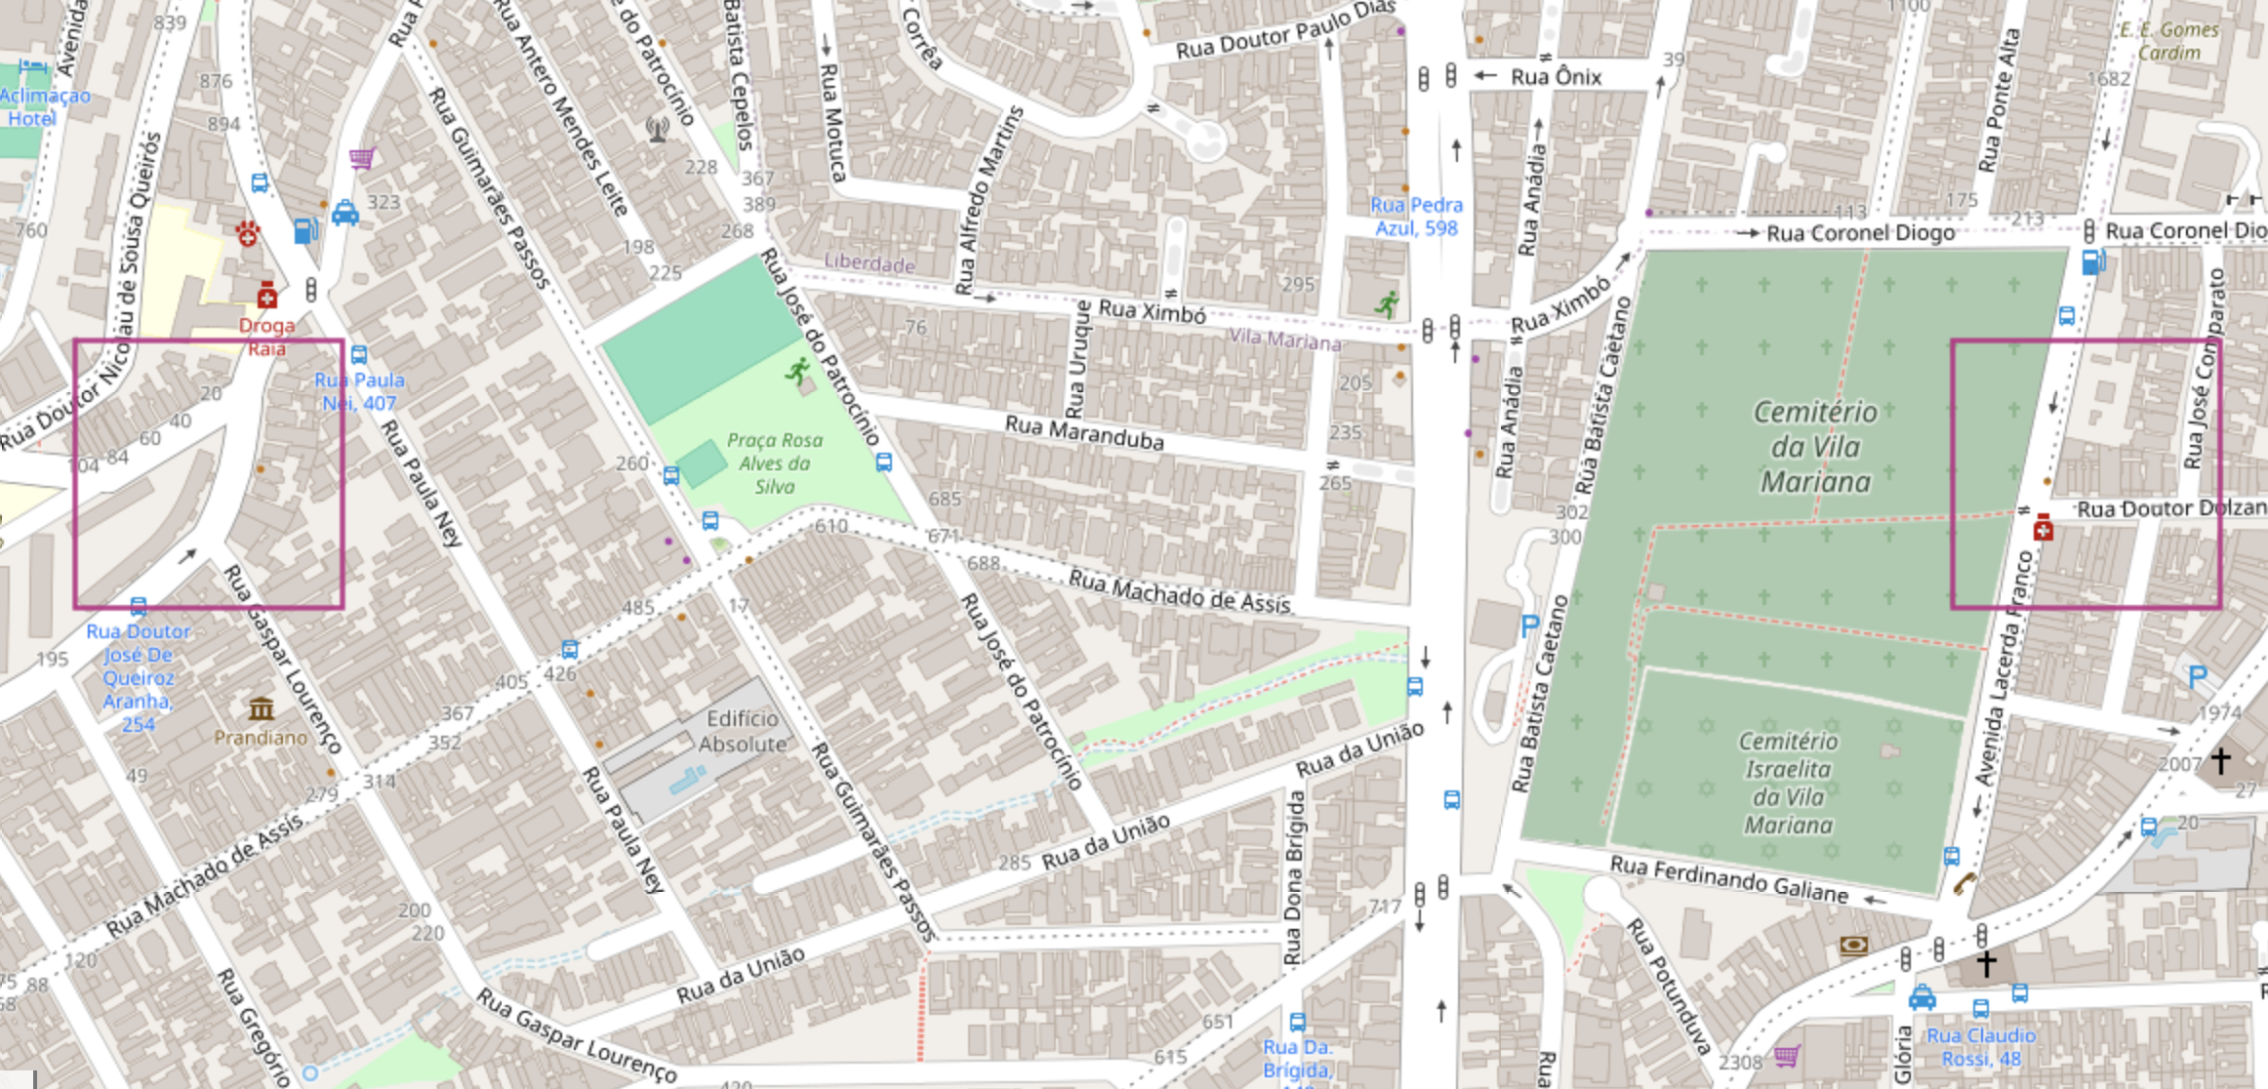

Slide 7
New Delhi, India
Unique admin level 1 names: ['Andaman and Nicobar' 'Andhra Pradesh' 'Arunachal Pradesh' 'Assam' 'Bihar' 'Chandigarh' 'Chhattisgarh' 'Dadra and Nagar Haveli' 'Daman and Diu' 'Goa' 'Gujarat' 'Haryana' 'Himachal Pradesh' 'Jammu and Kashmir' 'Jharkhand' 'Karnataka' 'Kerala' 'Lakshadweep' 'Madhya Pradesh' 'Maharashtra' 'Manipur' 'Meghalaya' 'Mizoram' 'Nagaland' 'NCT of Delhi' 'Odisha' 'Puducherry' 'Punjab' 'Rajasthan' 'Sikkim' 'Tamil Nadu' 'Telangana' 'Tripura' 'Uttar Pradesh' 'Uttarakhand' 'West Bengal’]
Unique admin level 2 names in NCT of Delhi:[‘West’]
Level 1 type: States
Level 2 type: Districts

Slide 8
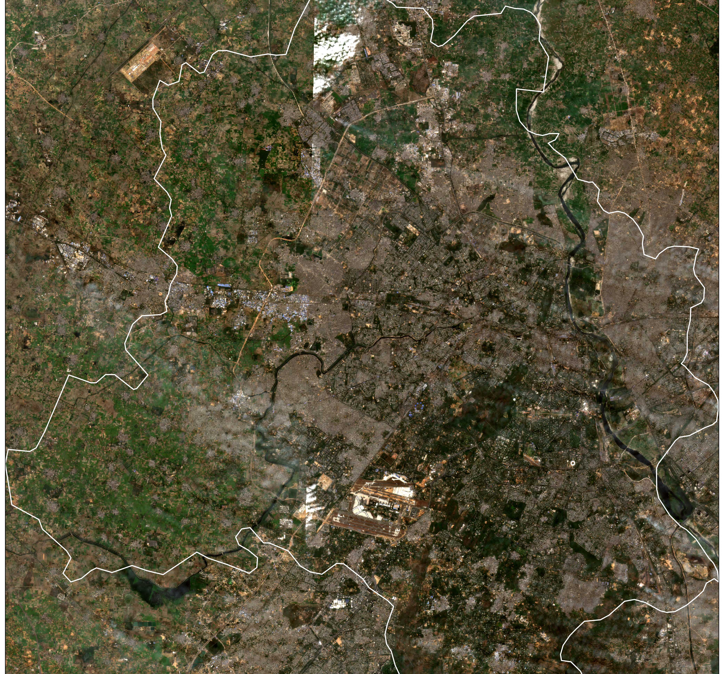
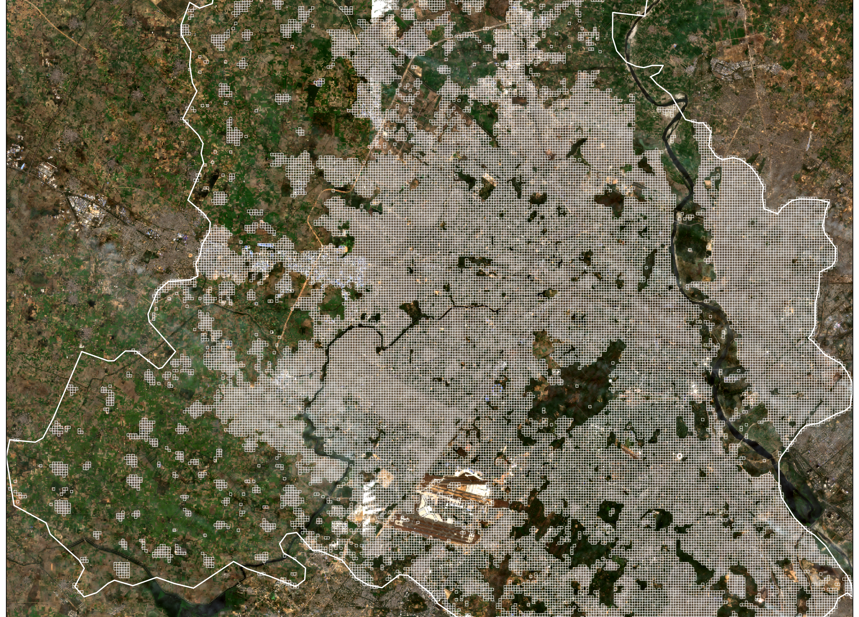


Slide 9
